Slide 1

Vehicles chasing each other around
a closed course with varying properties

Slide 2

Lane Detection Subsystem
Problem
Detecting lane lines out of a captured image in real time
DUAYENLER

Slide 3
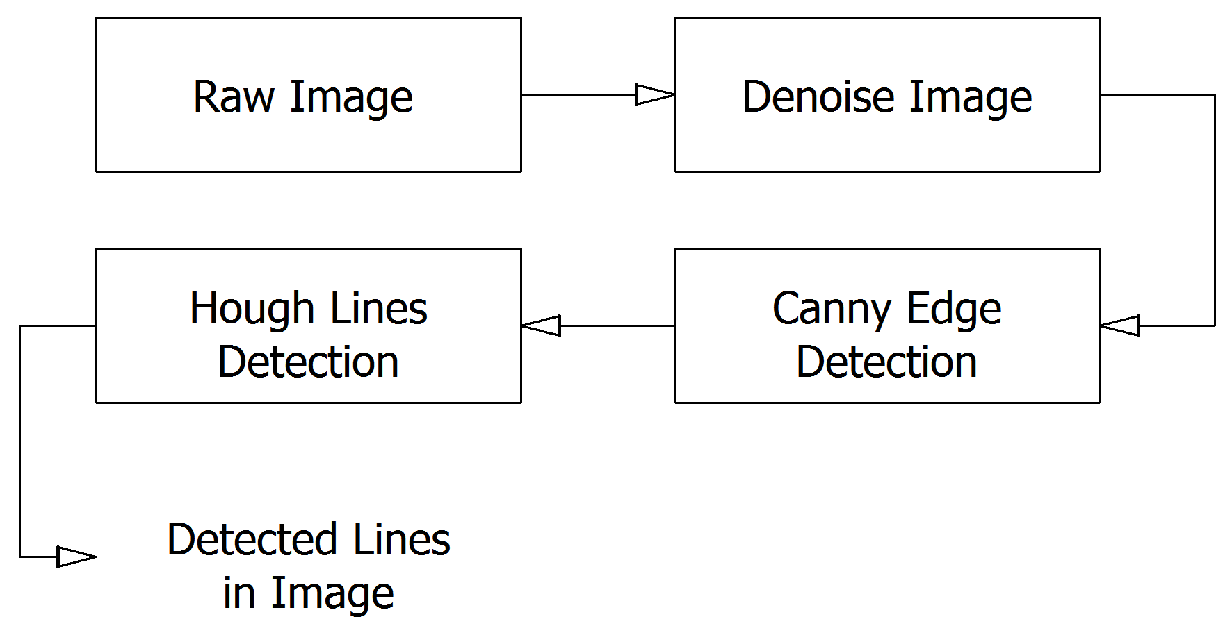
Lane Detection Subsystem
Solution
DUAYENLER

Slide 4
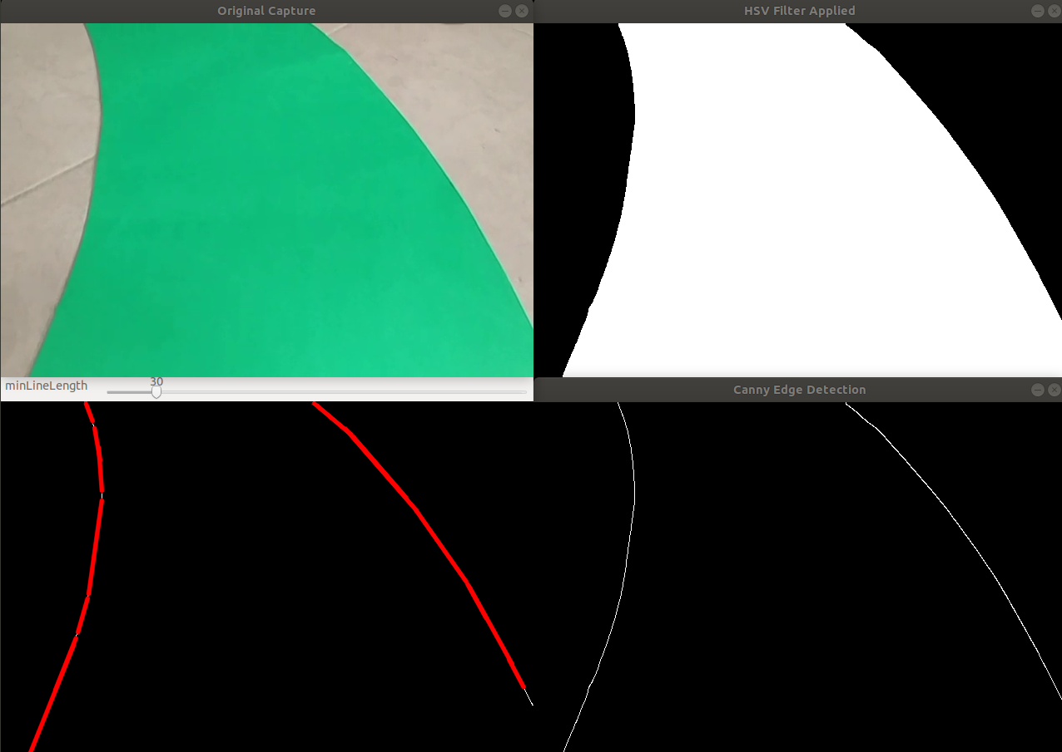
Lane Detection Subsystem
Sample Outputs of Color Filtering, Canny Edge Detection and Hough lines
DUAYENLER

Slide 5
Data Processing Subsystem
Problem
Determining the turn angle and direction out of the found lines in the image
DUAYENLER

Slide 6
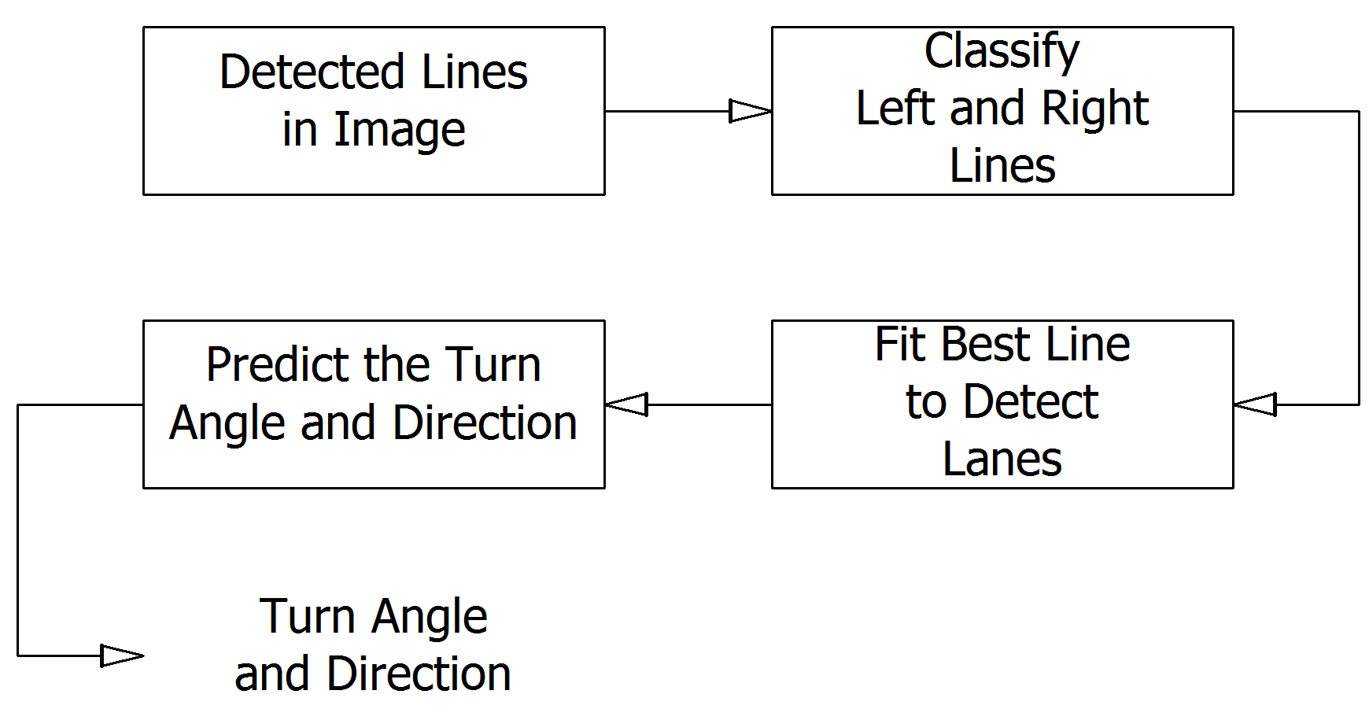
Data Processing Subsystem
Solution
DUAYENLER

Slide 7
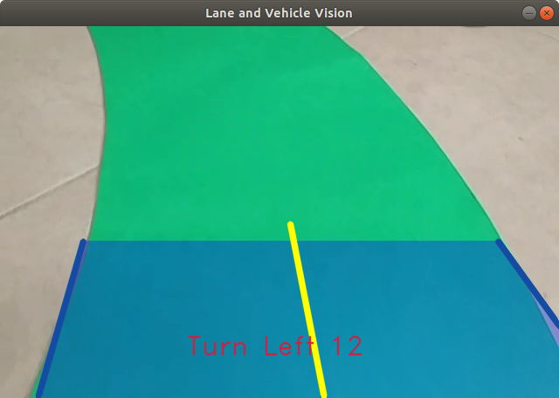
Data Processing Subsystem
Sample Output of Data Processing Subsystem
DUAYENLER

Slide 8
Lane Vision of the Vehicle
Sample Realtime Video Containing the Turn Angle and Direction
DUAYENLER

